Slide 1
How a senior engineer with 30+ years under his belt stayed and advanced on the technical track
Keith Wedinger
Senior Product Engineer
Empora Title

Slide 2
Agenda
Before we get started
Motivation
How I got here
Commitment
Challenge yourself
How to hear “Yes”
Imposter syndrome
Advocates
Company and culture
Sharpen the saw
Track and evaluate

Slide 3


Slide 4

Before we get started
No need to write down or take pics of slide deck content
Presentation link: https://bit.ly/3b2FUDZ
Please stop me at any time to ask questions

Slide 5
About Empora Title
New fintech startup focusing on reinventing the real estate title business
https://www.emporatitle.com
We’re hiring!

Slide 6
Motivation
“Your work is going to fill a large part of your life, and the only way to be truly satisfied is to do what you believe is great work. And the only way to do great work is to love what you do. If you haven't found it yet, keep looking. Don't settle.” – Steve Jobs

Slide 7
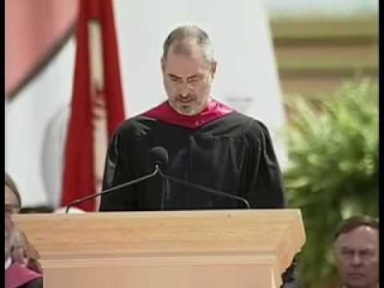

Slide 8
Motivation
The most qualified and motivated person to advance your career is yourself. If you depend upon others to advance your career, you will be gravely disappointed.

Slide 9
How I got here
I am a nerd!

Slide 10
How I got here
I get bored!

Slide 11
How I got here
I tried being a manager

Slide 12










How I got here

Slide 13
Commitment
What is your dream job?
Use this as your career guidepost

Slide 14
Challenge yourself
Get sh*t done
Excel at what you are doing
Get out of your comfort zone

Slide 15
Imposter Syndrome
What if I’m not good enough, I don’t know enough?
Can lead to staying in your comfort zone
Trust yourself and your abilities
Be proud of your accomplishments and sell them
It’s OK to say “I don’t know”

Slide 16
Advocates
Yourself
Your manager
Your network
Your recruiter

Slide 17
Company and culture
Dual career track
Internal opportunities and transfers

Slide 18
How to hear “Yes”
What is required?
How do I measure up?
If I hear “No”, how do I fill the gaps?

Slide 19
Sharpen the saw
Side projects
Mentor/mentee
Conferences and networking

Slide 20
Track and evaluate
Work diary
Update resume regularly
How are things aligning with your dream job?

Slide 21
Remember
Don’t settle!

Slide 22
Questions
keith.wedinger@hey.com
Twitter: @jkwuc89
LinkedIn: https://www.linkedin.com/in/kwedinger
GitHub: https://github.com/jkwuc89
Untapped (for craft 🍺 folks): jkwuc89
This presentation: https://bit.ly/3b2FUDZ
Thanks for attending!

